Slide 1
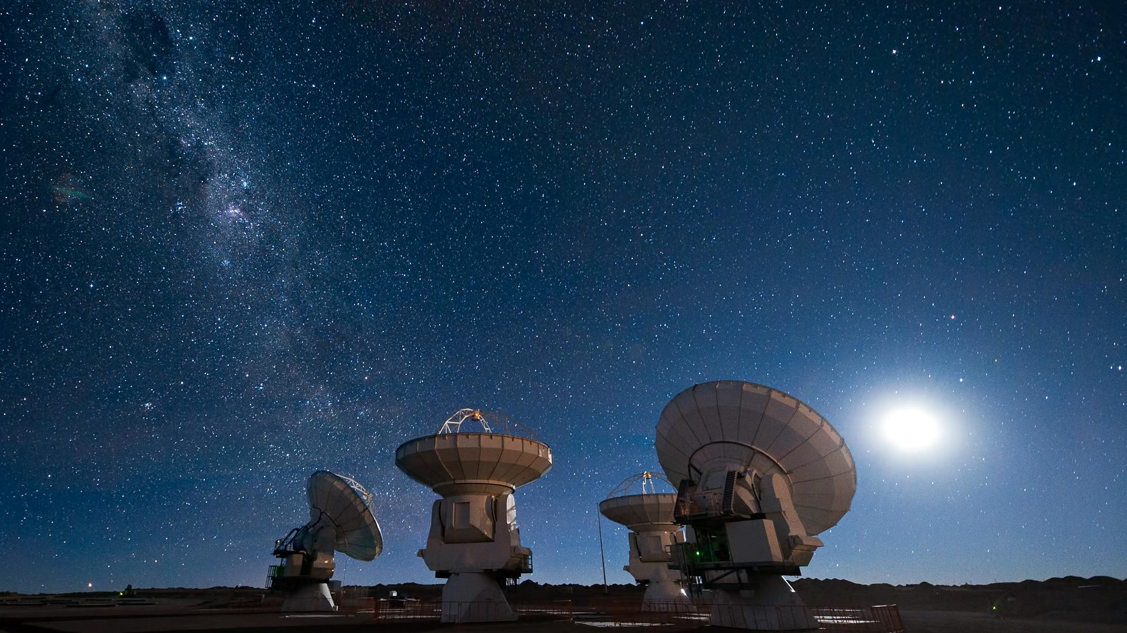
A data science approach to operations data at the ALMA Observatory
Haley Egan, Diana Morris, Matt Litz
April 27, 2023
Notes:
Diana

Slide 2
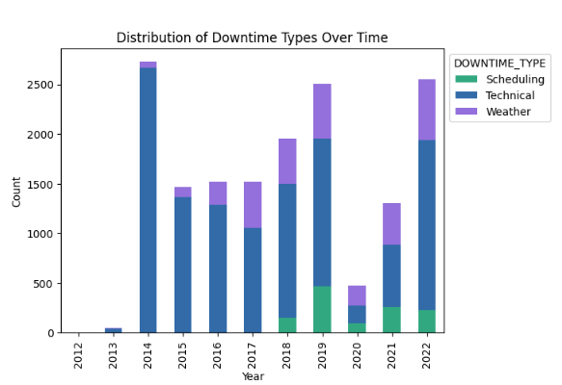

Overview
Our project had the following steps:
Shift data: focus on weather & technical downtimes
Analyze & further classify downtimes
Aim to improve operational efficiency
Notes:
We started with shift data from the observatory. A shift is a block of time dedicated to a science-related observation. But within a shift, there can also be downtimes caused by bad weather, technical issues, or scheduling problem. We focused on the first two kinds of downtimes in this project, and worked on further classification of those downtimes.

Slide 3
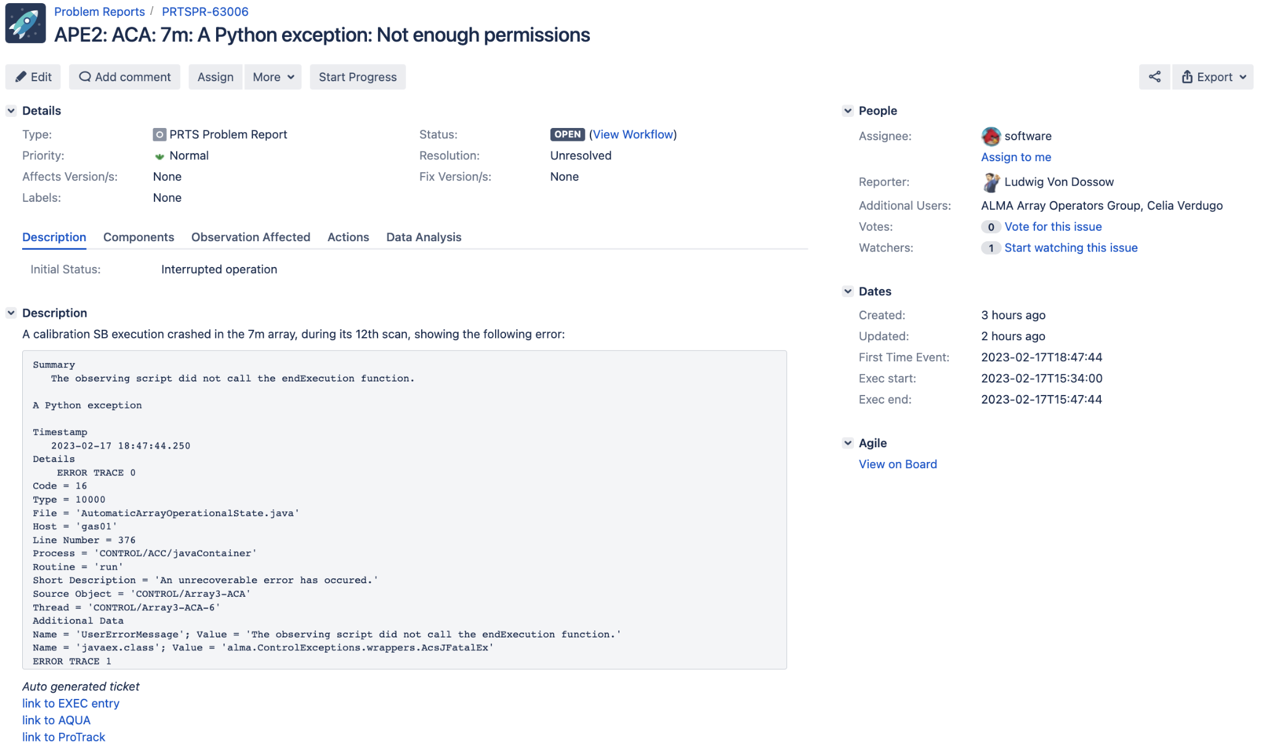

Jira Tickets for Reporting Technical Problems
Classify technical downtimes as software / hardware
Jira - problem reporting tool
7,613 tickets in dataset
6,940 Hardware Tickets
673 Software Tickets
2013-2023
Limited/no data 2020-2021 due to Covid-19
Notes:
Haley

Slide 4
Jira Ticket Analysis
Methods:
Jira JSON dataframe
LDA - Latent Dirichlet Allocation
Topic modeling & key phrase extraction
BERT - Transformer-Based Language Model
Results:
Extracted top key phrases (*examples in appendix)
Best accuracy w/ BERT using summary text only
94% accuracy, AUC 97.9%
Recall 93.8%, Precision 94%, F1 Score 93.9%
Notes:
Haley

Slide 5
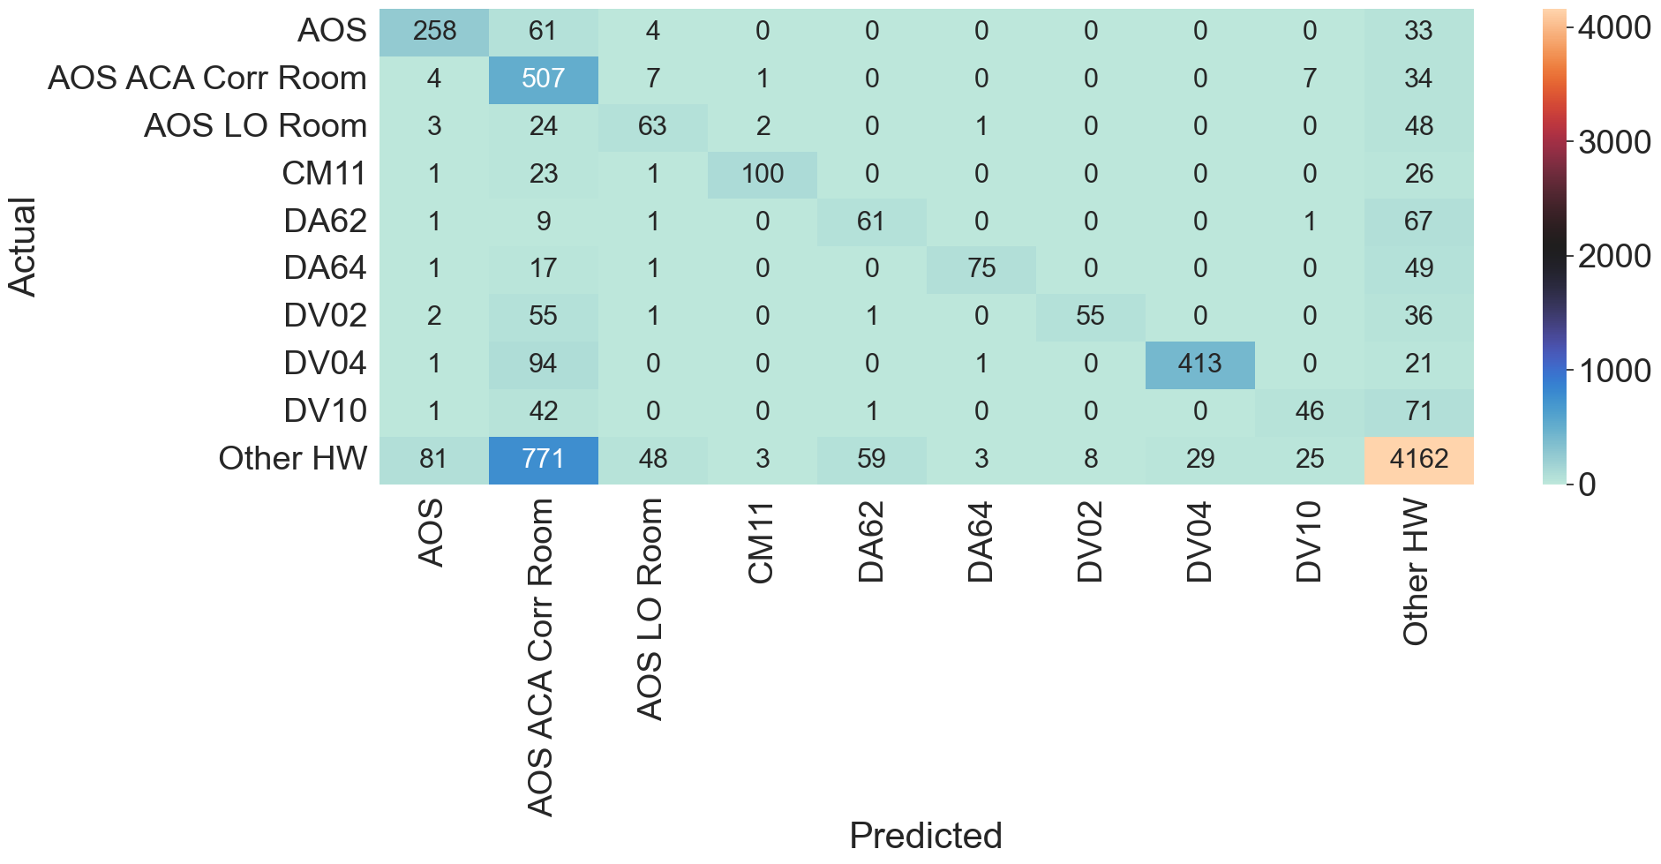
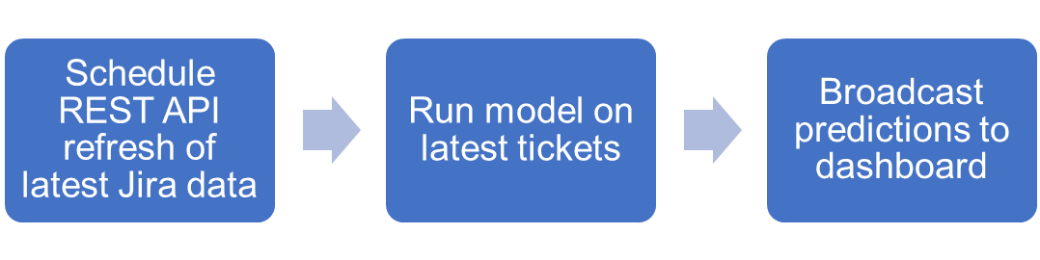
Classifying Technical Problem Root Causes
Historical records of hardware & software root causes used to train a BERT model
Hardware Problem Location labels: 435
Hardware labels: 203
Software labels: 50
Goal: as an operator enters Jira ticket information, model will immediately predict root cause
Improved performance can be achieved with additional text summarization
Multiclass Confusion Matrix of Top Occurring Hardware Labels
Prototype Dataiku MLOps Pipeline
Notes:
Matt
AOS ACA Corr Room: Precision = 91%, Recall = 32%
DV04: Precision = 78%, Recall = 93%
Precision: positive predictive value
Recall: True Positive Rate

Slide 6
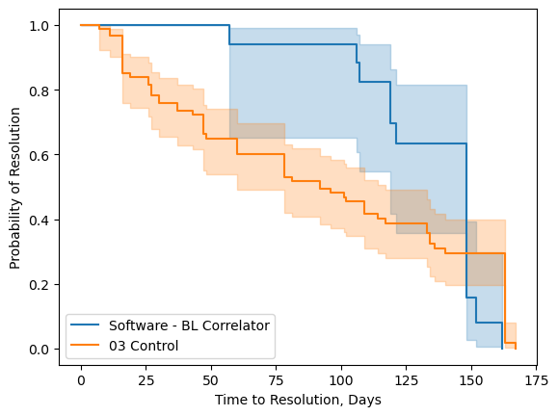
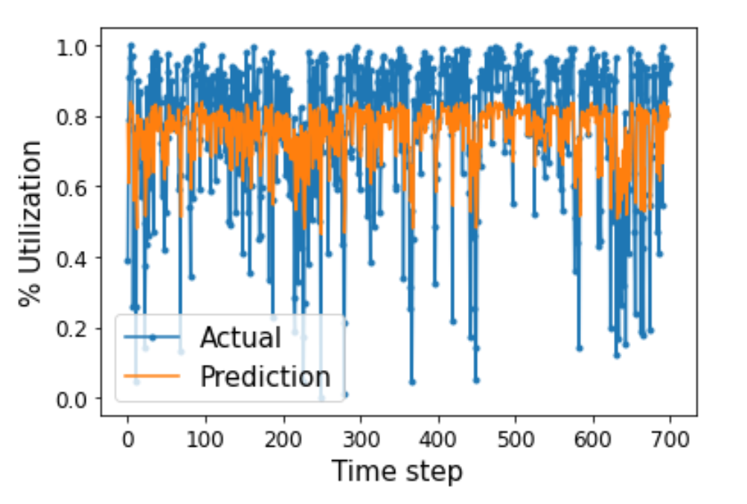
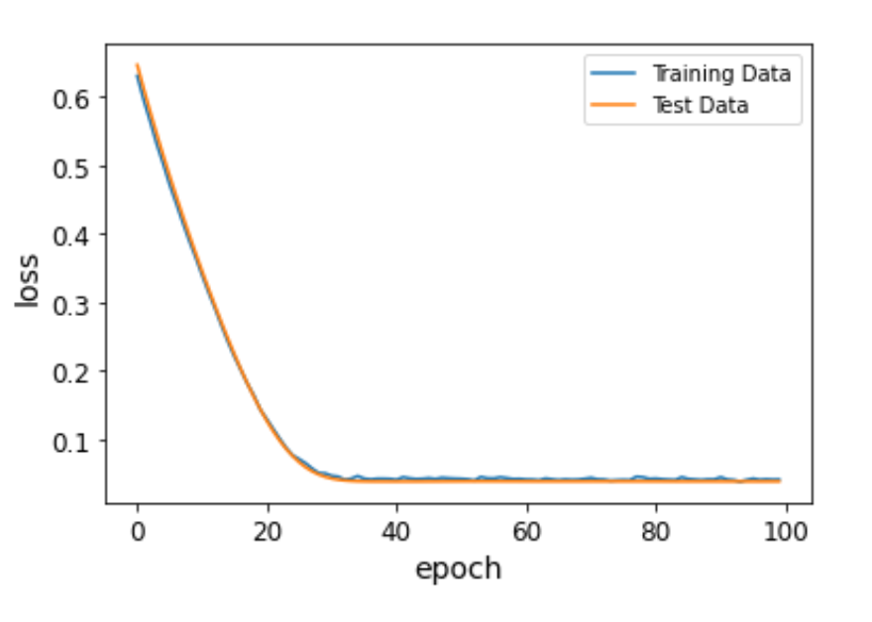
Planning for Downtimes
Example Survival Curves for Software Ticket Time-to-Resolutions
Using the historical data, prototype tools were developed for ALMA to manage downtimes
Hardware/Software Time-to-Resolution Duration
Kaplan-Meier Survival curves
Could assist ALMA with predicting the time to problem resolution for hardware failures
Time-series modeling of operations utilization
Utilization = [Successful Science Obs. / Allocated Time] per day
Univariate LSTM model
Help ALMA prepare for periods of decreased utilization
Predicted vs Actual % Daily Utilization
Notes:
Matt

Slide 7
Weather Data
Raw Data
Wind speed, humidity, pressure, temperature, PWV (water vapor), phase RMS (atmospheric instability)
Reported every 6 minutes (potentially), at up to 9 stations around the array
2010-2023
Cleaning
Averaged each category over all reporting stations for single category reading at each time
Identified & removed data from faulty sensors
Notes:
Diana

Slide 8
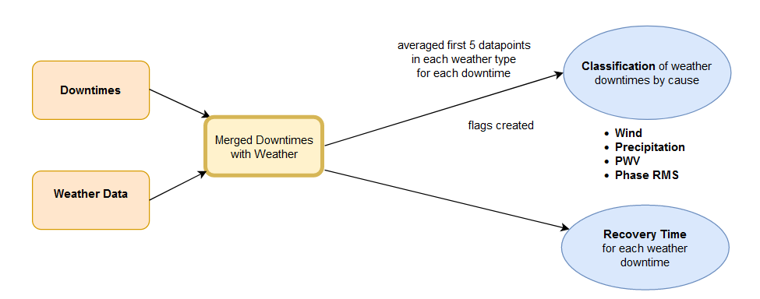
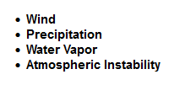
Weather Data Process
Notes:
Diana

Slide 9
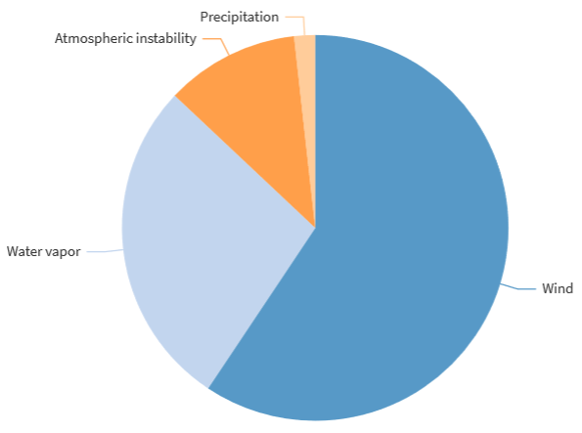
Weather Downtime by Primary Cause
Notes:
Diana

Slide 10
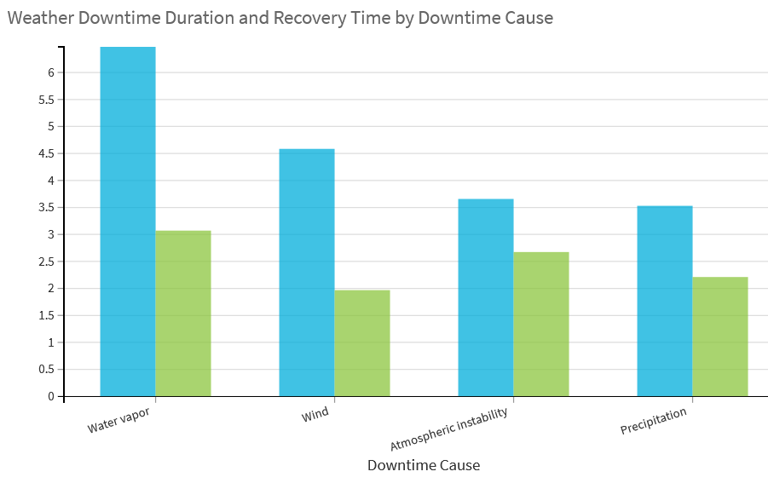

Notes:
Diana

Slide 11
Summary
Data engineering
BERT - classify hardware & software problems
LDA - extract key phrases
Weather - predict downtimes, duration & recovery times
Next Steps:
Summarize Jira description text - OpenAI API
Hierarchical classification of specific topics (i.e. antenna, correlator, bands)
Standardize reporting systems - reduce human error
Automate data collection & predictive modeling
Thank you!
Notes:
Haley

Slide 12
Appendix
Additional work & visualizations

Slide 13
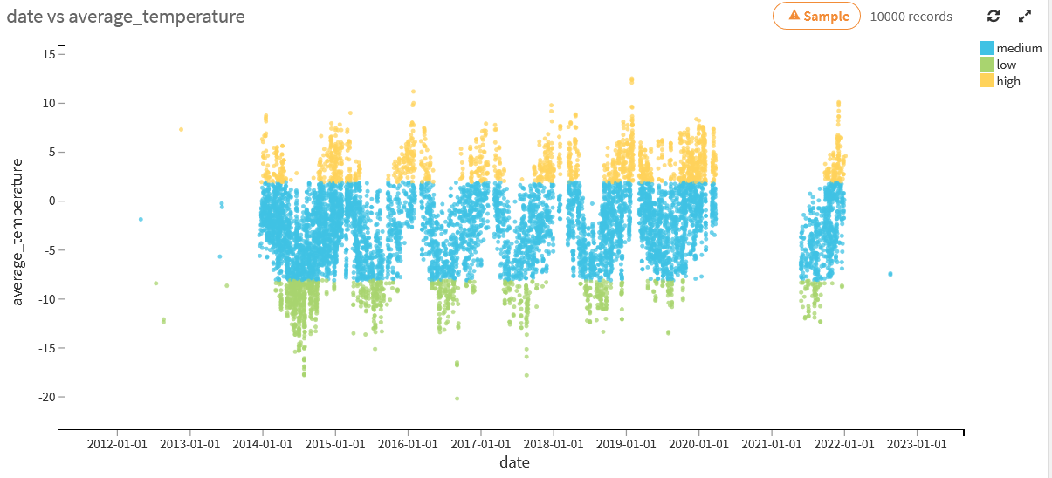
Dataset slide ideas
Shift-log data - reports generated per event at the observatory
Executions e.g. calibrations, science observations
Downtimes (technical, weather, scheduling)
Vast collection of weather-related data
Wind speed, humidity, pressure, temperature
Reports every 6 minutes (potentially), at up to 9 stations around the array
JIRA tickets - reports generated with each technical downtime
Time period: 2012-2023
Notes:
Should the title be plural? After all, we had several datasets.

Slide 14
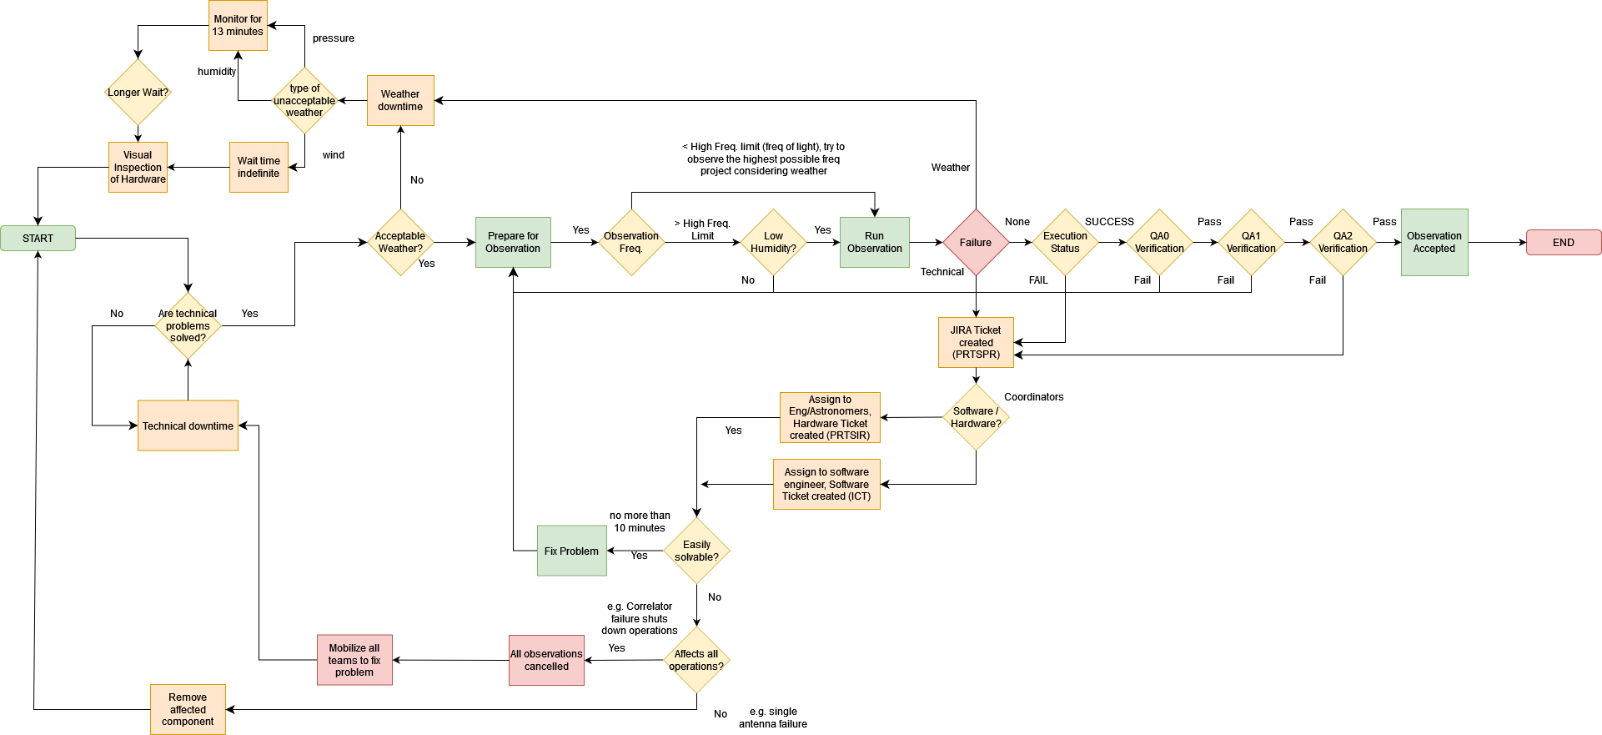
Process Map
Weather Downtimes: Classification opportunity
Hardware/Software Downtimes: Classification opportunity
Opportunity to predict length of repair

Slide 15

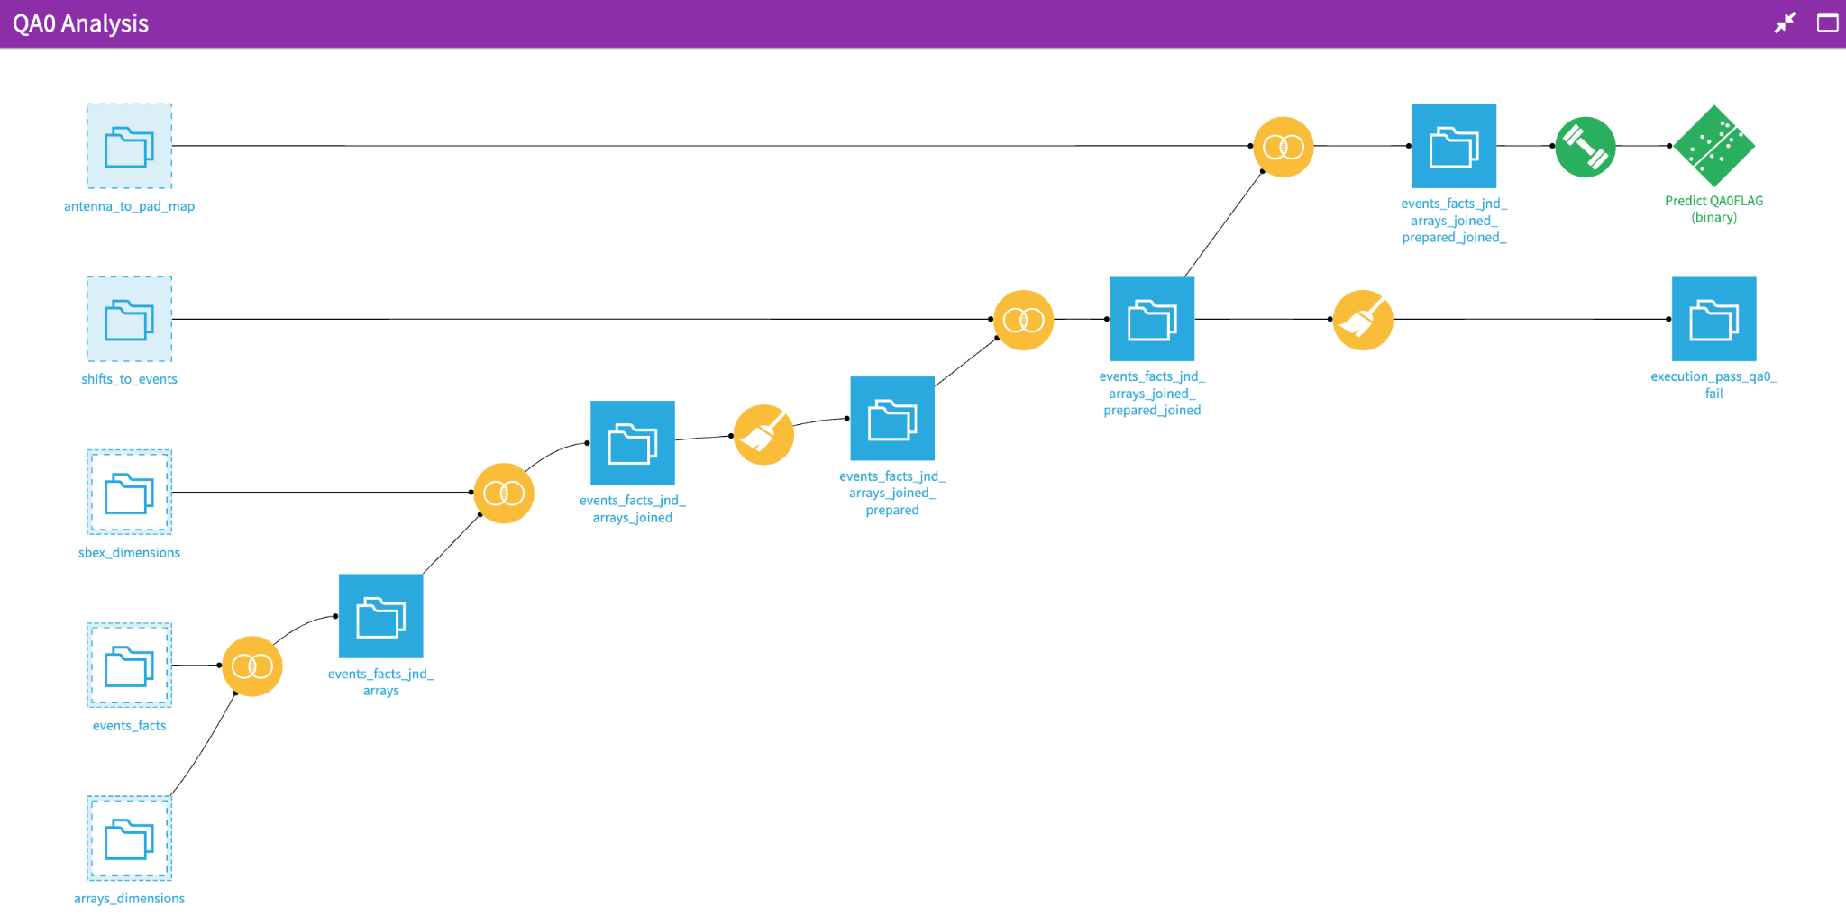
Dataiku Platform
ALMA has recently adopted the dataiku platform for their data management
A data science software platform that allows users to collaborate on projects using code, extensive built-in tools, and visualizations.
Machine learning, statistical models, EDA and NLP are easily incorporated into a project.
Data preparation
Machine Learning model
Notes:
Diana

Slide 16
Distribution of Downtime Types Over Time

Slide 17
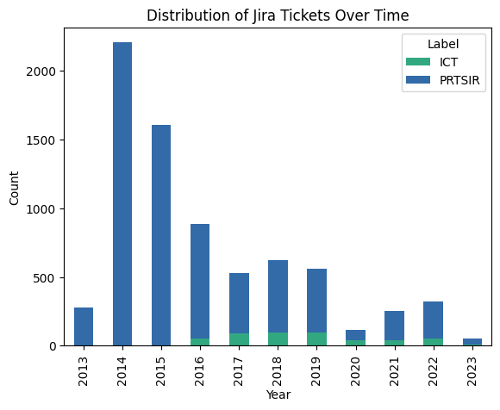
Distribution of Jira Tickets - Hardware vs Software

Slide 18
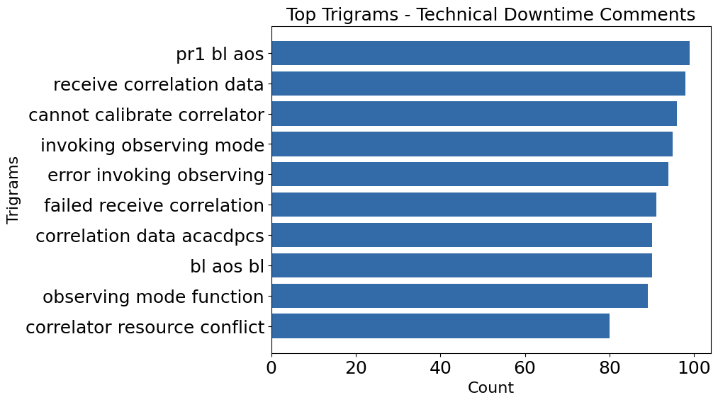
Key Phrases - Shiftlog Technical Downtimes

Slide 19
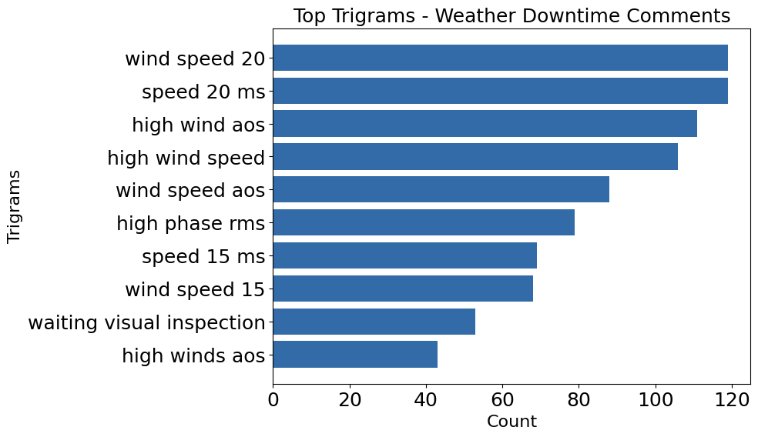
Key Phrases - Shiftlog Weather Downtimes

Slide 20
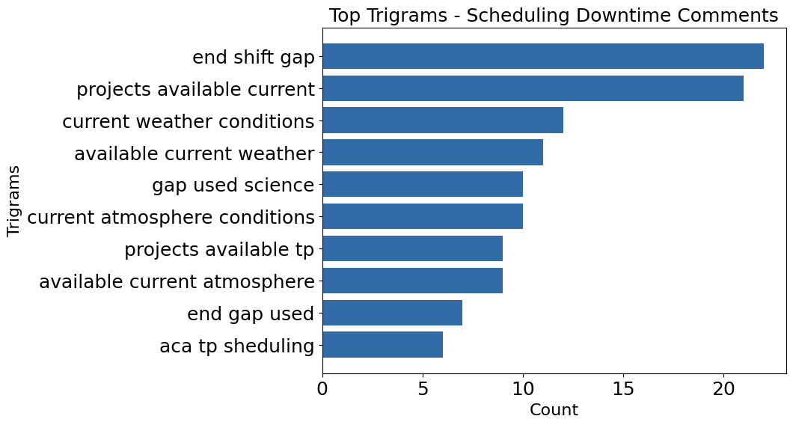
Key Phrases - Shiftlog Technical Downtimes

Slide 21
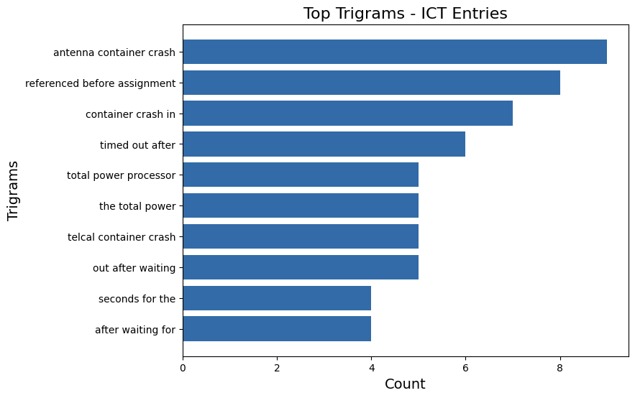
Key Phrases - Software (ICT) Jira Tickets

Slide 22
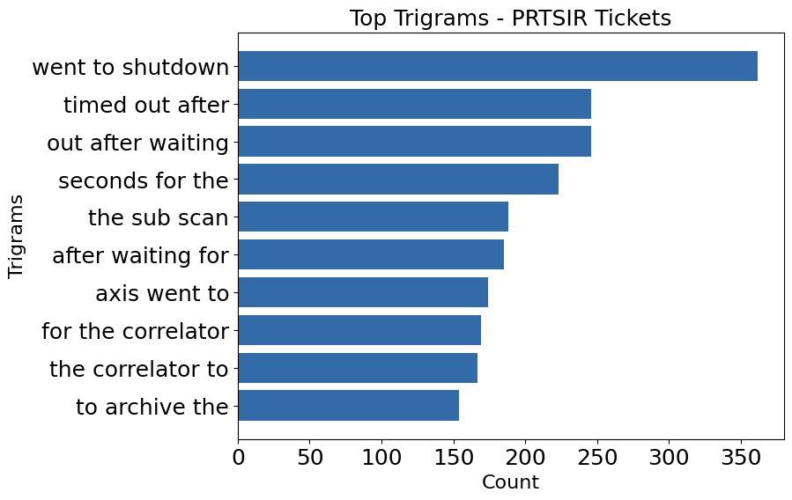
Key Phrases - Hardware (PRTSIR) Jira Tickets

Slide 23
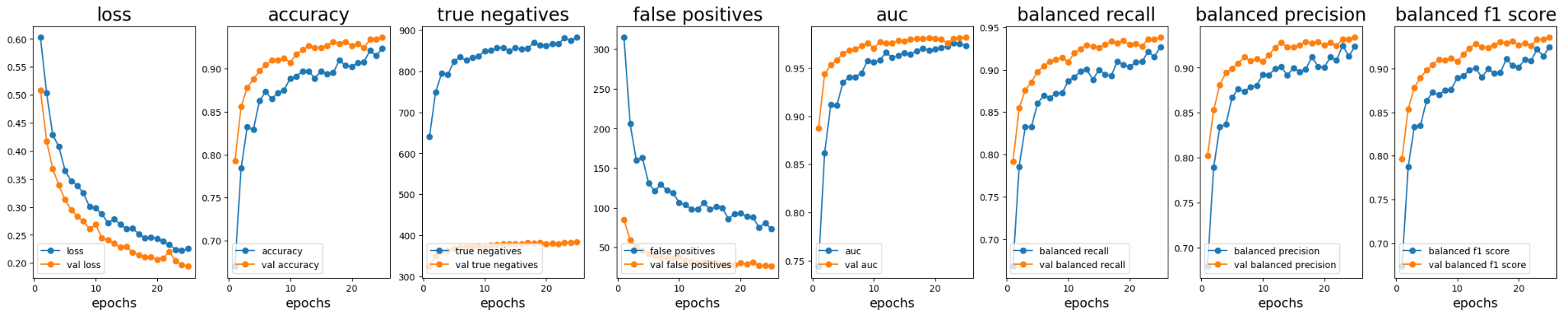
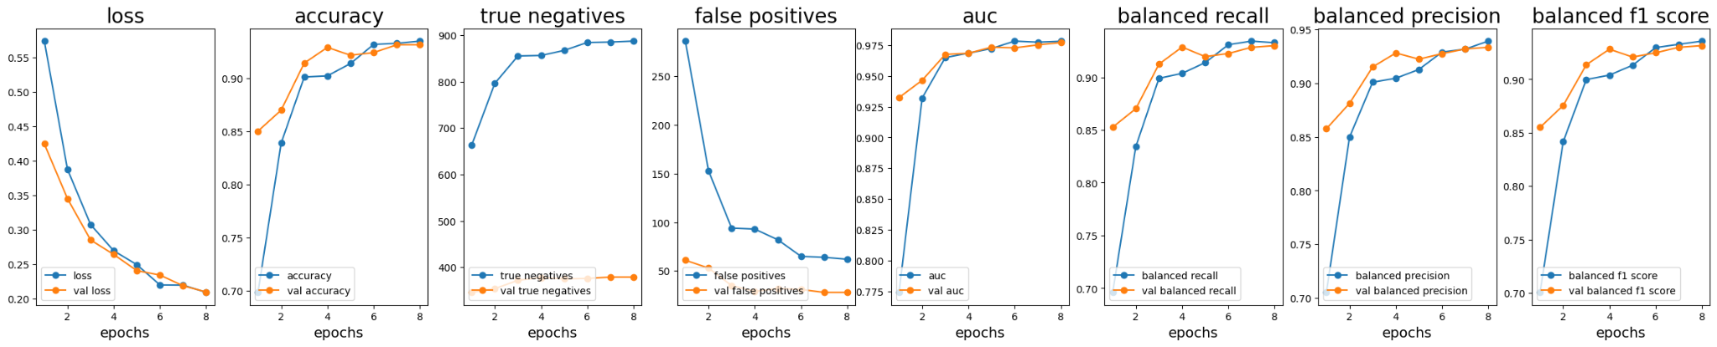
BERT with Jira Tickets - Evaluation Metrics
Classifying Hardware vs Software Jira Tickets with Description & Summary Text
Classifying Hardware vs Software Jira Tickets with Summary Text

Slide 24
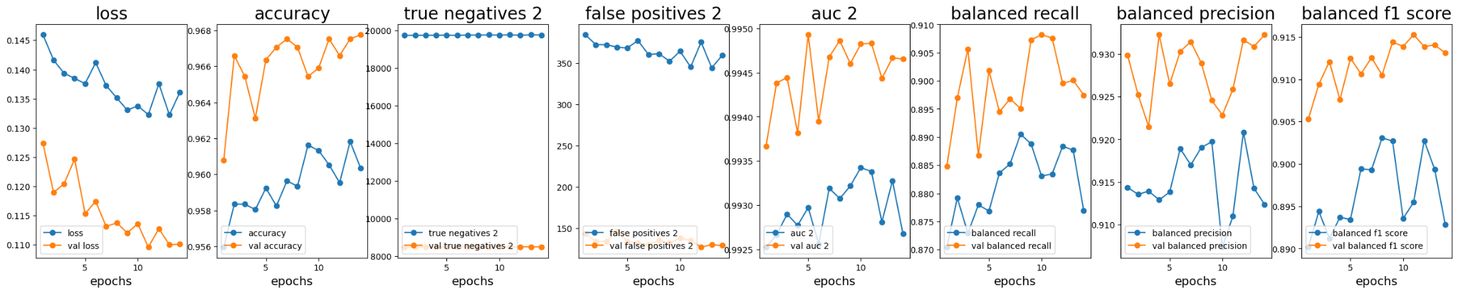
BERT with Shiftlog Downtime Comments - Evaluation Metrics
Classifying Technical, Weather & Scheduling Downtimes

Slide 25
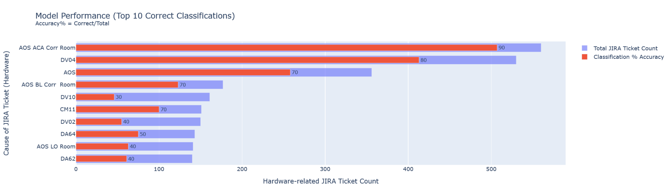

Slide 26
